Slide 1

newTRENDs:
New trends in
Energy demand modeling
First stakeholder workshop
newTRENDs and policies
22.10.2021
Dr. Heike Brugger
Fraunhofer ISI
This project has received funding from the European Union’s Horizon 2020 research and innovation programme under grant agreement no. 893311.

Slide 2
aGENDA
Welcome and overview of the newTRENDs project
Policies influencing energy demand arising from new societal trends
Focus group discussions (parallel sessions)
  Prosumagers and big data related to the built environment
  Circular economy for the deep decarbonisation of industry
  Digitalization and new market trends in the tertiary sector
  Shared economy in transport
Plenary discussion on focus group results and interlinkages

Slide 3

New Societal Trends
arising from Megatrends
potential impact
  energy demand
  cross-sectoral demand shift
from “continuous or linear trends” to “disruptive or non-linear trends”
  Consumer to prosumagers
  Circular Economy & Low-carbon industry
  Digitalisation of economy & private lifes
  Shared Economy

Slide 4
Overall Project Aim
Developing the analytical basis for a
2050 Energy Efficiency Vision
taking into account these New Societal Trends
Increase the understanding
Improve the modelling
Explore the future impact

Slide 5
identifying and quantifying how New Societal Trends affect energy demand
Achieving the Aims by
combining Foresight Methods with Quantitative Model Runs
investigating how energy demand models can represent New Societal Trends
representing policies in energy demand models that influence New Societal Trends

Slide 6
integrating recent empirical findings on New Societal Trends into energy demand models
Achieving the Aims by
using Empirical Information on Consumption Patterns and Policy Impacts
improving the empirical basis for investigations of New Societal Trends by integrating detailed data
dealing with uncertainties that are inherent when assessing New Societal Trends

Slide 7
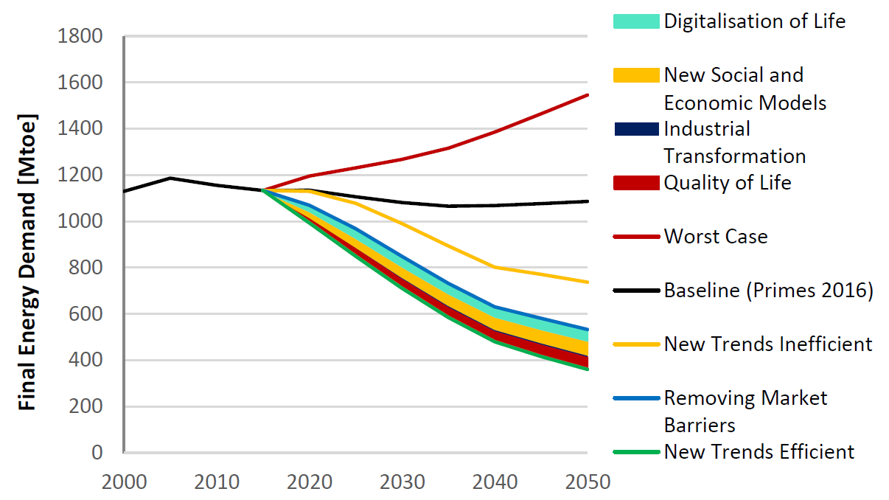
NewTRENDs’ empirical research design
– an iterative multi-method approach

Slide 8
an iterative multi-method approach

Slide 9

Brief summary from the breakout sessions
Prosumagers and big data related to the built environment
Circular economy for the deep decarbonisation of industry
Digitalization and new market trends in the tertiary sector
Shared economy in transport

Slide 10
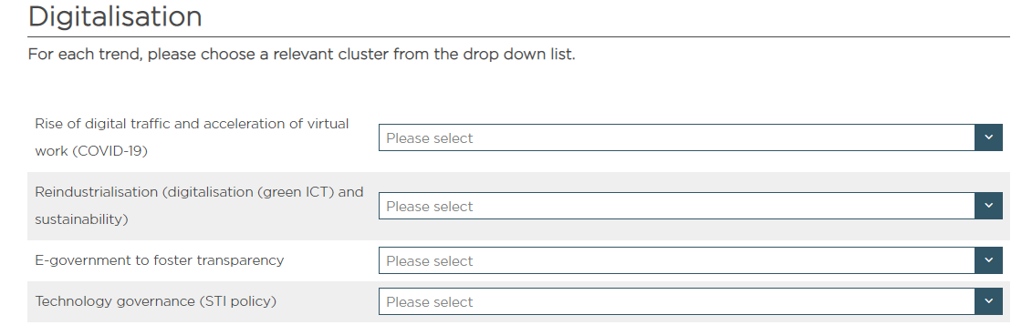
expert Survey: how are the various trends interconnected?
Analysis of Trend Clusters
Aim: identification of interlinkages between the clusters
Online survey, requires 5-10 min

Slide 11
newTRENDs
Stakeholder workshop
Thank you for your attention!
Dr. Heike Brugger
Coordinator of the Business Unit Energy Policy
Competence Center Energy Policy and Energy Markets
Fraunhofer Institute for Systems and Innovation Research ISI
Breslauer Straße 48 | 76139 Karlsruhe | Germany
mailto: heike.brugger@isi.fraunhofer.de

Slide 12
Development of Narratives
– Example of Digitalization
Potentially increasing energy demand through:
  Increased data traffic (not countervailed by efficiency improvements in the long run)
  Production and transportation of hardware
  Reindustrialization of the EU
  ...
Potentially decreasing energy demand through:
  increasing (material) efficiency
  Processes and services on demand
  ...
Shifting energy demand
  Reindustrialization of the EU
Policies
  Full life cycle of products
  `Green’ industrial processes
  Integrated digitalization
Medium to high impact
Global mega trend (macro scale)

